Slide 1
Today’s Class
CS F212 Database Systems
E R Model

Slide 2
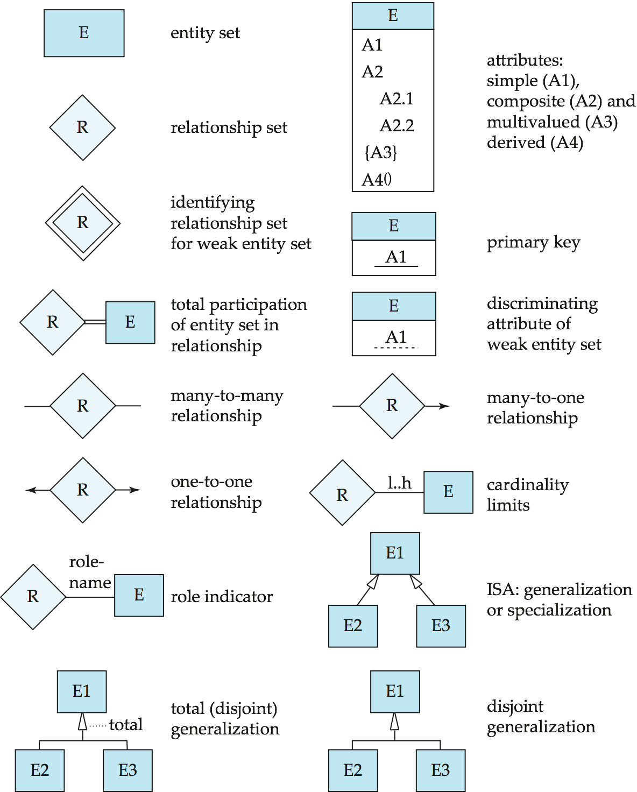
Summary of Symbols Used in E-R Notation

Slide 3
Symbols Used in E-R Notation (Cont.)

Slide 4
RELATIONSHIPS (Cont…)
Example: A library database contains a listing of authors that have written books on various subjects. It also contains information about libraries that carry books on various subjects.
Entity sets: authors, subjects, books, libraries
Relationship sets: wrote, carry, indexed

Slide 5
RELATIONSHIPS (Cont…)
Subject
matter
title
isbn
SS#
authors
wrote
books
index
subject
name
carry
address
libraries

Slide 6
E-R Design Decisions
The use of an attribute or entity set to represent an object.
Whether a real-world concept is best expressed by an entity set or a relationship set.
The use of a ternary relationship versus a pair of binary relationships.
The use of a strong or weak entity set.
The use of specialization/generalization – contributes to modularity in the design.
The use of aggregation – can treat the aggregate entity set as a single unit without concern for the details of its internal structure.

Slide 7
Conceptual Design Using the ER Model
Design choices:
Should a concept be modeled as an entity or an attribute?
Should a concept be modeled as an entity or a relationship?
Identifying relationships: Binary or ternary? Aggregation?
Constraints in the ER Model:
A lot of data semantics can (and should) be captured.
But some constraints cannot be captured in ER diagrams.
Notes:
3

Slide 8
Design Techniques
Avoid redundancy.
Limit the use of weak entity sets.
Don’t use an entity set when an attribute will do.

Slide 9
Valid E/R Diagrams
An E/R diagram is valid if and only if:
It is syntactically correct (e.g. specifies all key constraints,…)
It specifies the entity types, relationship types, attribute types, and subtype relationships necessary to satisfy all information requirements.
It does not specify any invalid constraints.

Slide 10
Priorities when Choosing Between Valid E/R Diagrams
Express all constraints (you can express!)
Use and do not change terminology and class structure of the application domain
Keep it simple (avoid defining entity types that do not serve any purpose)
Avoid redundancy (but derived attributes are okay)!

Slide 11
E/R Diagram Design – Typical Errors
Missing Constraints
Unexpressed Constraints due to bad design
Every entity type needs a key
Attribute associated with the wrong entity type (relationship type)
Missing existence dependencies (use subclasses)
Invalid constraints
Using Subtypes for n:1 relationships; using relationships when subtypes should be used.
When defining relationships: Too general entity types for participating entities
Too many entity types
Using foreign keys instead of relationships

Slide 12
Other Issues in E/R Design
No relationships of relationships --- solution: create an entity type that represent instances of the relationship (or use aggregation as discussed)
value or entity type --- solution: choose entity type if it helps expressing constraints; otherwise, use value-type.

Slide 13
IPL E/R Design --- Ungraded Homework --- due: Wed., Feb. 19,2014
Design an Entity-Relationship Diagram that models the following entities and relationships in the world of Cricket (IPL): teams, players, games, managers and contracts. Each (IPL) team has a unique team name, and a city it plays in. Each person being part of the IPL has a unique IDNO and a name. Additionally, for players their weight, height, playing position and birth dates are of importance. Players have a contract with at most one team and receive a salary for their services, and teams have at least 15 and at most 49 players under contract. Each team has one to three managers; managers can work for at most 4 teams and receive a salary for each of their employments. Players cannot be managers. A game involves a home-team and visiting-team; additionally, the day of the game, and the score of the game are of importance; teams play each other several times in a season (not on the same day!). Moreover, for each game played we like to know which players participated in the game and how many minutes they played.
Indicate the cardinalities for each relationship type; assign roles (role names) to each relationship if there are ambiguities! Use sub-types, if helpful to express constraints!

Slide 14
A University Database
Design an entity-relationship diagram that describes the following objects in a university application: students, professors, and courses. Students take a course in a particular semester and receive a grade for their performance. Sometimes students take the same course again in different semester. There are no limits on how many courses a student can take, and on how many students completed a particular course. Each student has exactly one advisor, who must be a professor, whereas each professor allowed being the advisor of at most 20 students. Courses have a unique course number and a course title. Students and professors have a name and a unique SSN. Students additionally have a GPA and a single or multiple major.

Slide 15
A movie studio might have several film crews. The crews might be designated by a given studio as crew 1, crew 2, and so on. However, other studios might use the same designations for crews, so the attribute number is not a key for crews. Rather, to name a crew uniquely, we need to give both the name of the studio to which it belongs and the number of crew. The key for the weak entity set Crews is its own number attribute and the name attribute of the unique studio to which the crew is related by the many-one Unit-of relationship.

Slide 16
Exercise 2.4 A company database needs to store information about employees (identified by ssn, with salary and phone as attributes), departments (identified by dno, with dname and budget as attributes), and children of employees (with name and age as attributes). Employees work in departments; each department is managed by an employee; a child must be identified uniquely by name when the parent (who is an employee; assume that only one parent works for the company) is known. We are not interested in information about a child once the parent leaves the company. Draw an ER diagram that captures this information.

Slide 17
Summary of Conceptual Design
Conceptual design follows requirements analysis,
Yields a high-level description of data to be stored
ER model popular for conceptual design
Constructs are expressive, close to the way people think about their applications.
Note: There are many variations on ER model
Both graphically and conceptually
Basic constructs: entities, relationships, and attributes (of entities and relationships).
Some additional constructs: weak entities, ISA hierarchies, and aggregation.
Notes:
11

Slide 18
Summary of ER (Cont.)
Several kinds of integrity constraints:
key constraints
participation constraints
overlap/covering for ISA hierarchies.
Some foreign key constraints are also implicit in the definition of a relationship set.
Many other constraints (notably, functional dependencies) cannot be expressed.
Constraints play an important role in determining the best database design for an enterprise.
Notes:
12

Slide 19
Summary of ER (Cont.)
ER design is subjective. There are often many ways to model a given scenario!
Analyzing alternatives can be tricky, especially for a large enterprise. Common choices include:
Entity vs. attribute, entity vs. relationship, binary or n-ary relationship, whether or not to use ISA hierarchies, aggregation.
Ensuring good database design: resulting relational schema should be analyzed and refined further.
Functional Dependency information and normalization techniques are especially useful.
Notes:
13

Slide 20
From ER Model to Relational Model
So… how do we convert an ER diagram into a table?? Simple!!
Basic Ideas:
Build a table for each entity set
Build a table for each relationship set if necessary (more on this later)
Make a column in the table for each attribute in the entity set
Indivisibility Rule and Ordering Rule
Primary Key

Slide 21
ER to Relational Model
General principles
Entity set => a relation with same attributes
Relationship => a relation whose attributes are keys from participating entity sets + descriptive attributes if any
Special situations
Weak entity sets
Entity Hierarchies (ISA relationships)
Merging relations

Slide 22
Example – Strong Entity Set
SID
Name
PSRN
Name
Student
Advisor
Professor
Major
Dept
GPA
SID | Name | Major | GPA
1234 | John | CS | 2.8
5678 | Mary | EE | 3.6
PSRN | Name | Dept
9999 | Smith | Math
8888 | Lee | CS

Slide 23
Reduction to Relation Schemas
Entity sets and relationship sets can be expressed uniformly as relation schemas that represent the contents of the database.
A database which conforms to an E-R diagram can be represented by a collection of schemas.
For each entity set and relationship set there is a unique schema that is assigned the name of the corresponding entity set or relationship set.
Each schema has a number of columns (generally corresponding to attributes), which have unique names.

Slide 24
Logical DB Design: ER to Relational
Entity sets to tables:
CREATE TABLE Employees
(psrn INTEGER,
name CHAR(20),
dept CHAR(12),
PRIMARY KEY (ssn))
name
psrn
dept
Employees
Notes:
3

Slide 25
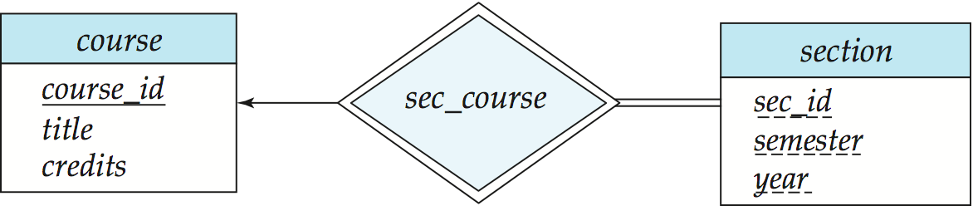
Representing Entity Sets With Simple Attributes
A strong entity set reduces to a schema with the same attributes student(ID, name, tot_cred)
A weak entity set becomes a table that includes a column for the primary key of the identifying strong entity set section ( course_id, sec_id, sem, year )

Slide 26
Representation of Weak Entity Set
Weak Entity Set Cannot exists alone
To build a table/schema for weak entity set
Construct a table with one column for each attribute in the weak entity set
Remember to include discriminator
Augment one extra column on the right side of the table, put in there the primary key of the Strong Entity Set (the entity set that the weak entity set is depending on)
Primary Key of the weak entity set = Discriminator + foreign key

Slide 27
Representation of Relationship Set
--This is a little more complicated--
Unary/Binary Relationship set
Depends on the cardinality and participation of the relationship
Two possible approaches
N-ary (multiple) Relationship set
Primary Key Issue
Identifying Relationship
No relational model representation necessary

Slide 28
Representing Relationship Set Unary/Binary Relationship
For one-to-one relationship w/out total participation
Build a table with two columns, one column for each participating entity set’s primary key. Add successive columns, one for each descriptive attributes of the relationship set (if any).
For one-to-one relationship with one entity set having total participation
Augment one extra column on the right side of the table of the entity set with total participation, put in there the primary key of the entity set without complete participation as per to the relationship.

Slide 29
Example – One-to-One Relationship Set
Degree
SID
Name
ID Code
Student
study
Major
Major
GPA
SID | Maj_ID Co | S_Degree
9999 | 07 | 1234
8888 | 05 | 5678
* Primary key can be either SID or Maj_ID_Co

Slide 30
Example – One-to-One Relationship Set
Condition
SID
Name
1:1 Relationship
S/N #
Student
Have
Laptop
Major
GPA
Brand
SID | Name | Major | GPA | LP_S/N | Hav_Cond
9999 | Bart | Economy | -4.0 | 123-456 | Own
8888 | Lisa | Physics | 4.0 | 567-890 | Loan
* Primary key can be either SID or LP_S/N

Slide 31
Representing Relationship Set Unary/Binary Relationship
For one-to-many relationship w/out total participation
Same thing as one-to-one
For one-to-many/many-to-one relationship with one entity set having total participation on “many” side
Augment one extra column on the right side of the table of the entity set on the “many” side, put in there the primary key of the entity set on the “one” side as per to the relationship.

Slide 32
Example – Many-to-One Relationship Set
Semester
SID
Name
N:1 Relationship
SSN
Student
Advisor
Professor
Major
GPA
Dept
Name
SID | Name | Major | GPA | Pro_SSN | Ad_Sem
9999 | Bart | Economy | -4.0 | 123-456 | Fall 2006
8888 | Lisa | Physics | 4.0 | 567-890 | Fall 2005
* Primary key of this table is SID

Slide 33
Representing Relationship Set Unary/Binary Relationship
For many-to-many relationship
Same thing as one-to-one relationship without total participation.
Primary key of this new schema is the union of the foreign keys of both entity sets.
No augmentation approach possible…

Slide 34
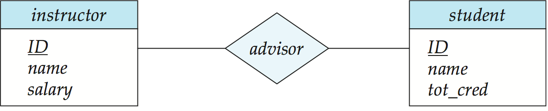
Representing Relationship Sets
A many-to-many relationship set is represented as a schema with attributes for the primary keys of the two participating entity sets, and any descriptive attributes of the relationship set.
Example: schema for relationship set advisor
advisor = (s_id, i_id)

Slide 35
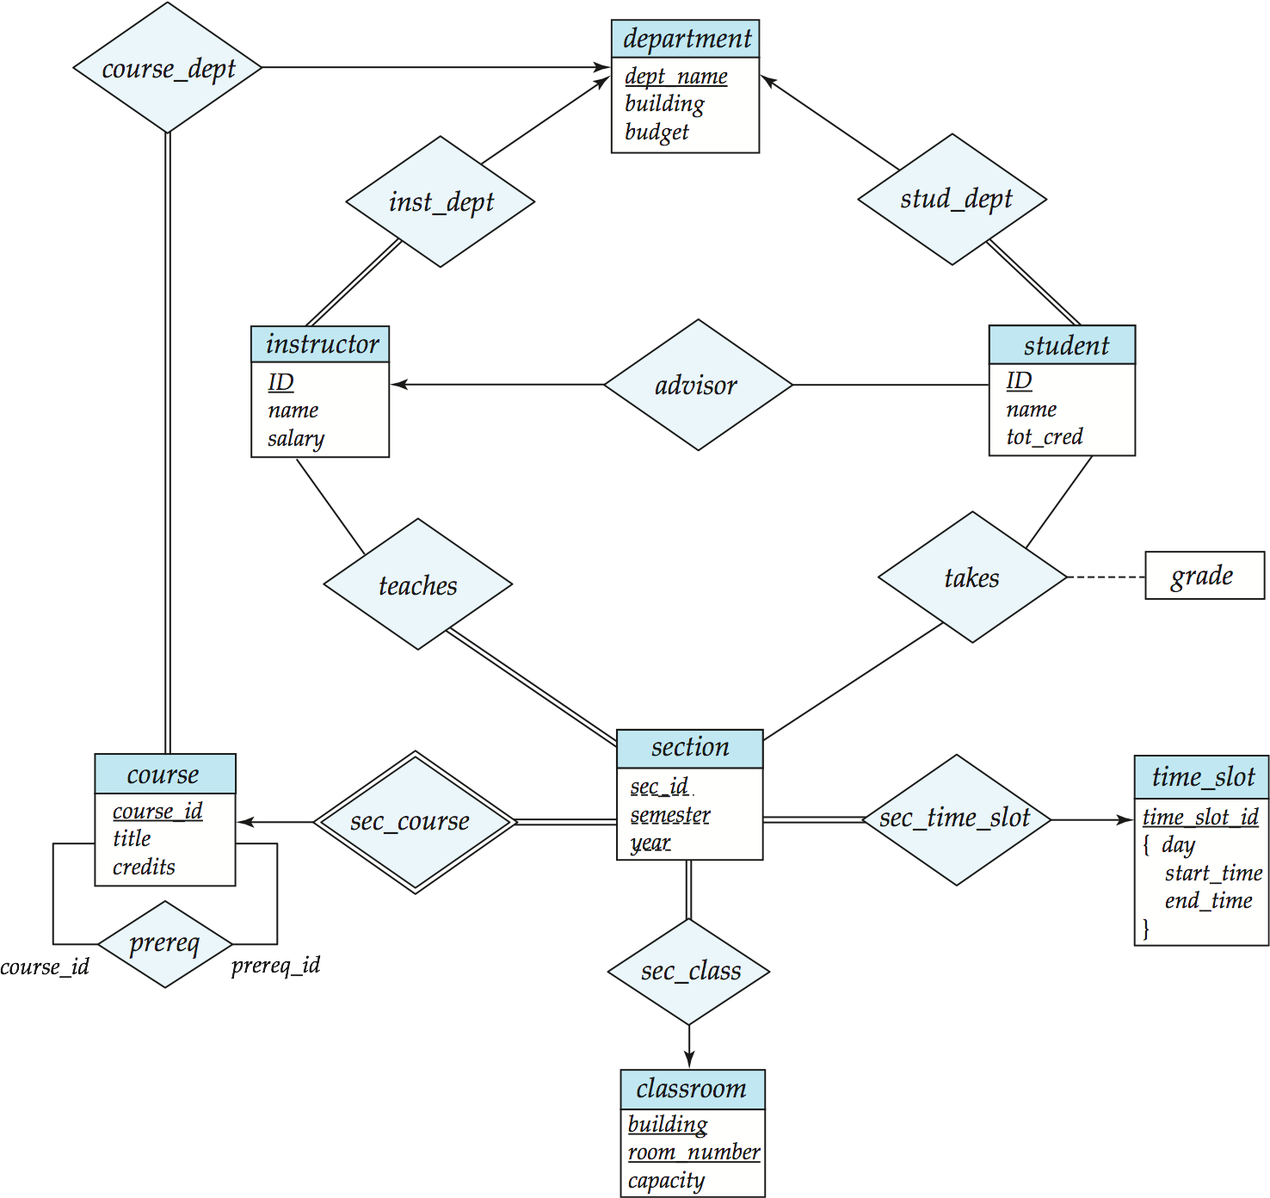
Redundancy of Schemas
Many-to-one and one-to-many relationship sets that are total on the many-side can be represented by adding an extra attribute to the “many” side, containing the primary key of the “one” side
Example: Instead of creating a schema for relationship set inst_dept, add an attribute dept_name to the schema arising from entity set instructor

Slide 36
Redundancy of Schemas
For one-to-one relationship sets, either side can be chosen to act as the “many” side
That is, extra attribute can be added to either of the tables corresponding to the two entity sets
If participation is partial on the “many” side, replacing a schema by an extra attribute in the schema corresponding to the “many” side could result in null values
The schema corresponding to a relationship set linking a weak entity set to its identifying strong entity set is redundant.
Example: The section schema already contains the attributes that would appear in the sec_course schema
Notes:
36

Slide 37
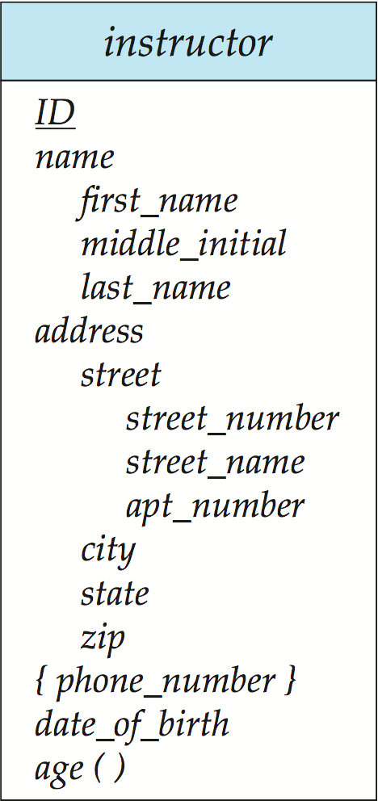
Composite and Multivalued Attributes
Composite attributes are flattened out by creating a separate attribute for each component attribute
Example: given entity set instructor with composite attribute name with component attributes first_name and last_name the schema corresponding to the entity set has two attributes name_first_name and name_last_name
Prefix omitted if there is no ambiguity
Ignoring multivalued attributes, extended instructor schema is
instructor(ID, first_name, middle_initial, last_name,street_number, street_name, apt_number, city, state, zip_code, date_of_birth)
Notes:
37

Slide 38
Composite and Multivalued Attributes
A multivalued attribute M of an entity E is represented by a separate schema EM
Schema EM has attributes corresponding to the primary key of E and an attribute corresponding to multivalued attribute M
Example: Multivalued attribute phone_number of instructor is represented by a schema: inst_phone= ( ID, phone_number)
Each value of the multivalued attribute maps to a separate tuple of the relation on schema EM
For example, an instructor entity with primary key 22222 and phone numbers 456-7890 and 123-4567 maps to two tuples: (22222, 456-7890) and (22222, 123-4567)
Notes:
38

Slide 39
Representing Composite Attribute
Relational Model Indivisibility Rule Applies
One column for each component attribute
NO column for the composite attribute itself
SSN
Name
SSN | Name | Street | City
9999 | Dr. Smith | 50 1st St. | Fake City
8888 | Dr. Lee | 1 B St. | San Jose
Professor
Address
Street
City

Slide 40
Representing Multivalue Attribute
For each multivalue attribute in an entity set/relationship set
Build a new relation schema with two columns
One column for the primary keys of the entity set/relationship set that has the multivalue attribute
Another column for the multivalue attributes. Each cell of this column holds only one value. So each value is represented as an unique tuple
Primary key for this schema is the union of all attributes

Slide 41
Example – Multivalue attribute
SID
Name
The primary key for this table is Student_SID + Children, the union of all attributes
Children
Student
Major
GPA
Stud_SID | Children
1234 | Johnson
1234 | Mary
5678 | Bart
5678 | Lisa
5678 | Maggie
SID | Name | Major | GPA
1234 | John | CS | 2.8
5678 | Homer | EE | 3.6

Slide 42
Multivalued Attributes (Cont.)
Special case:entity time_slot has only one attribute other than the primary-key attribute, and that attribute is multivalued
Optimization: Don’t create the relation corresponding to the entity, just create the one corresponding to the multivalued attribute
time_slot(time_slot_id, day, start_time, end_time)
Caveat: time_slot attribute of section (from sec_time_slot) cannot be a foreign key due to this optimization
Notes:
42

Slide 43
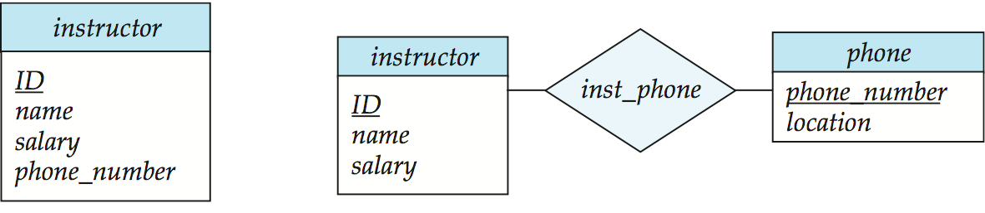
Design Issues
Use of entity sets vs. attributes
Use of phone as an entity allows extra information about phone numbers (plus multiple phone numbers)
Notes:
43

Slide 44
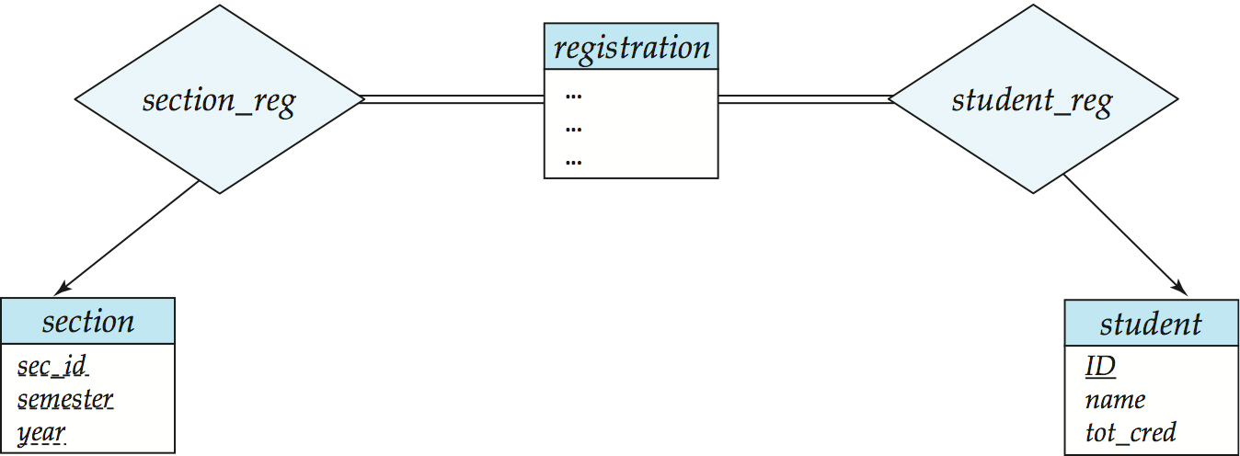
Design Issues
Use of entity sets vs. relationship sets Possible guideline is to designate a relationship set to describe an action that occurs between entities
Notes:
44

Slide 45
Design Issues
Binary versus n-ary relationship sets Although it is possible to replace any nonbinary (n-ary, for n > 2) relationship set by a number of distinct binary relationship sets, a n-ary relationship set shows more clearly that several entities participate in a single relationship.
Placement of relationship attributes
e.g., attribute date as attribute of advisor or as attribute of student
Notes:
45

Slide 46
Representing Relationship Set N-ary Relationship
Intuitively Simple
Build a new table with as many columns as there are attributes for the union of the primary keys of all participating entity sets.
Augment additional columns for descriptive attributes of the relationship set (if necessary)
The primary key of this table is the union of all primary keys of entity sets that are on “many” side
That is it, we are done.

Slide 47
Example – N-ary Relationship Set
P-Key1
D-Attribute
A-Key
E-Set 1
P-Key2
A relationship
Another Set
E-Set 2
P-Key3
E-Set 3
P-Key1 | P-Key2 | P-Key3 | A-Key | D-Attribute
9999 | 8888 | 7777 | 6666 | Yes
1234 | 5678 | 9012 | 3456 | No
* Primary key of this table is P-Key1 + P-Key2 + P-Key3

